Slide 1
COMP307 Week 2 (Tutorial)
Announcements
Assignment 1
When to start?
What to do now?
Helpdesk sessions
Nature of this course
Uncertainty:
Uncertain (AI)
Certain (other courses)
Solutions/answers:
Unique?
Best?
Good?
Algorithms/methods:
Step-by-step => the correct version (others)
Main ideas => many different versions (AI)
Details vs guidelines
Search (Lectures 2 & 3)
Search strategies
Uninformed
Informed
Beyond classic search
Classic vs. local search
(Genetic) Beam search
Machine Learning (Lecture 4)
Type of learning systems
Supervised learning
Unsupervised learning
Machine learning tasks
Classification
Regression
Clustering
Line fitting
Over-fitting

Slide 2
Uniform-Cost Search
a
2
2
c
b
goal
1
8
2
d
2
3
5
e
9
start
9
f
h
1
1
4
4
3
r
5
p
15
q

Slide 3
A* Search (1)
H=6
A
1
12
S
5
C
3
G
2
H=7
2
H=1
H=0
4
B
H=2

Slide 4
Classic vs. Local Search
Classic Search
Local Search
Assumptions:
Observable
Deterministic
known environment where the solution is a sequence of actions
The path is a solution
Useful for solving optimisation problems
Aim to find the best state according to an objective function
Only keep one state and its evaluation
Choose the best successor

Slide 5
(Genetic) Beam Search
G₀
G₁
G₂
G_{n-1}
Mating pool
Mating pool

Slide 6
Supervised Learning (Classification)
Training Set
Learning System
Test Set
Learned Classifier
Green Class
Blue Class
Red Class

Slide 7
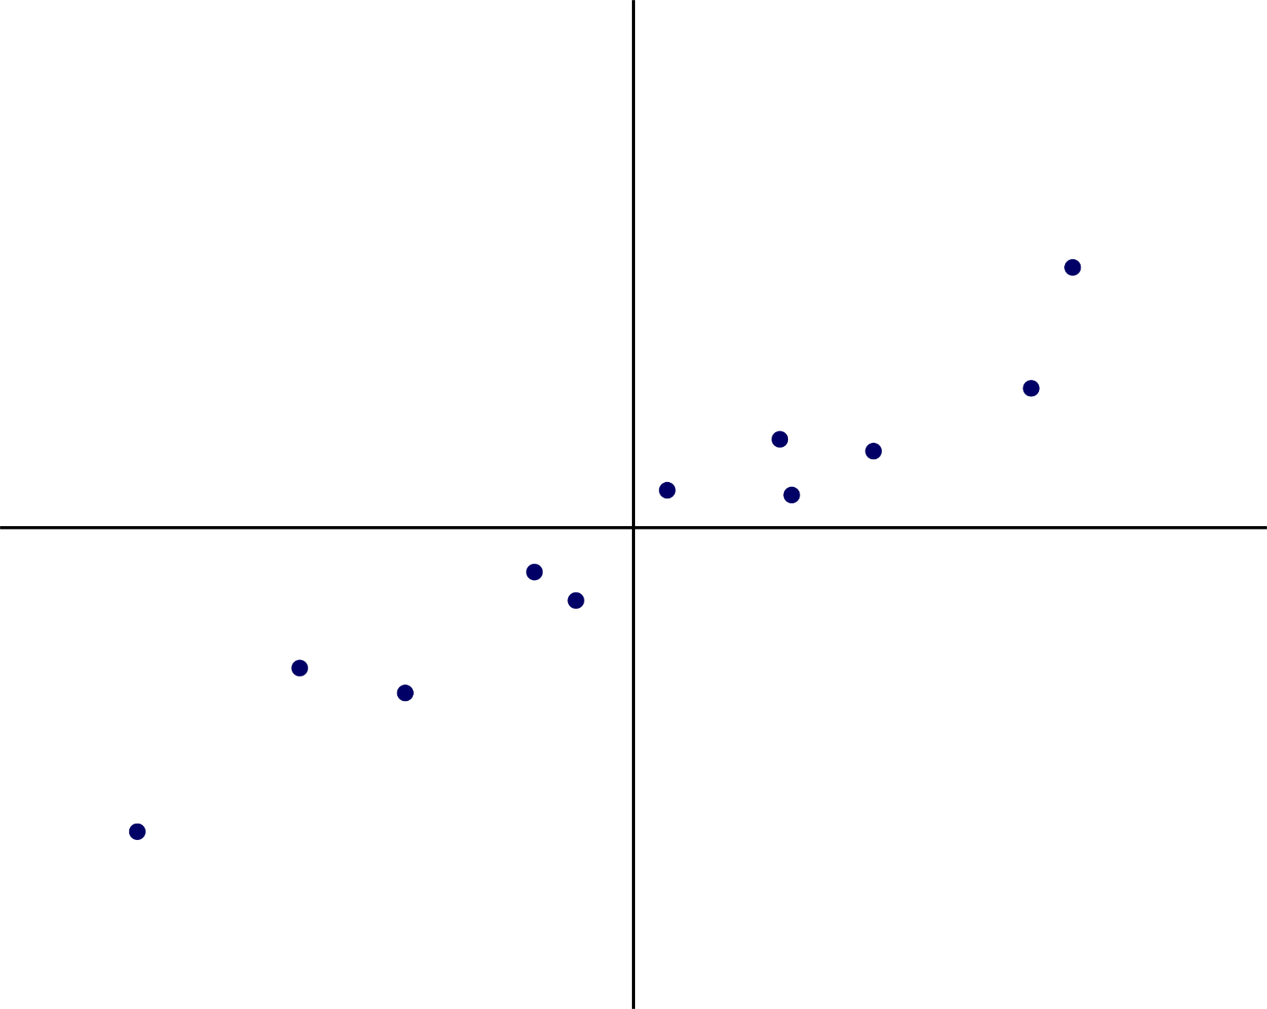
Supervised Learning (Regression)

Slide 8
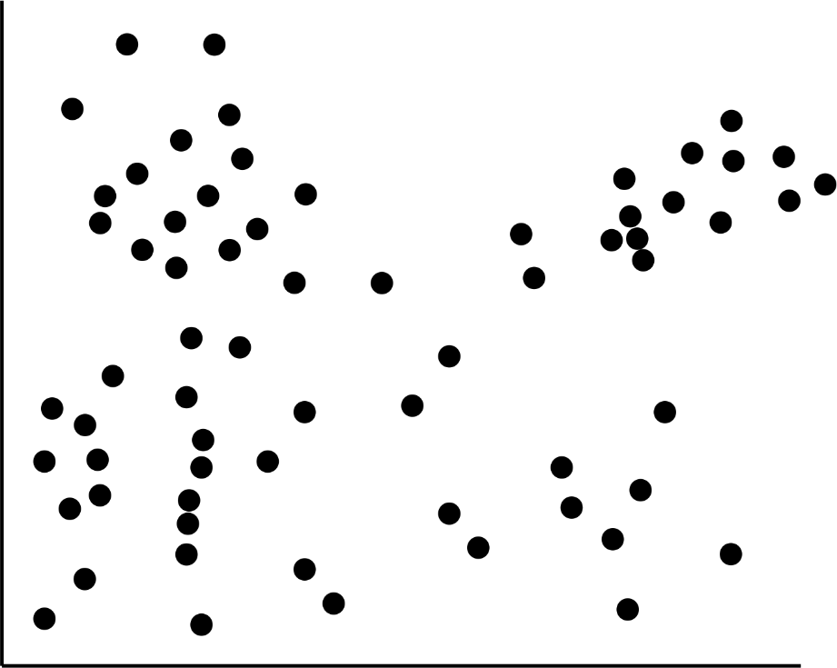
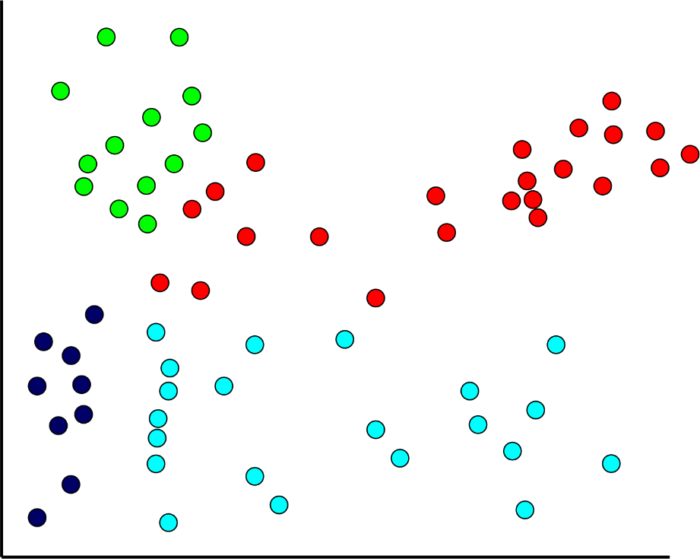
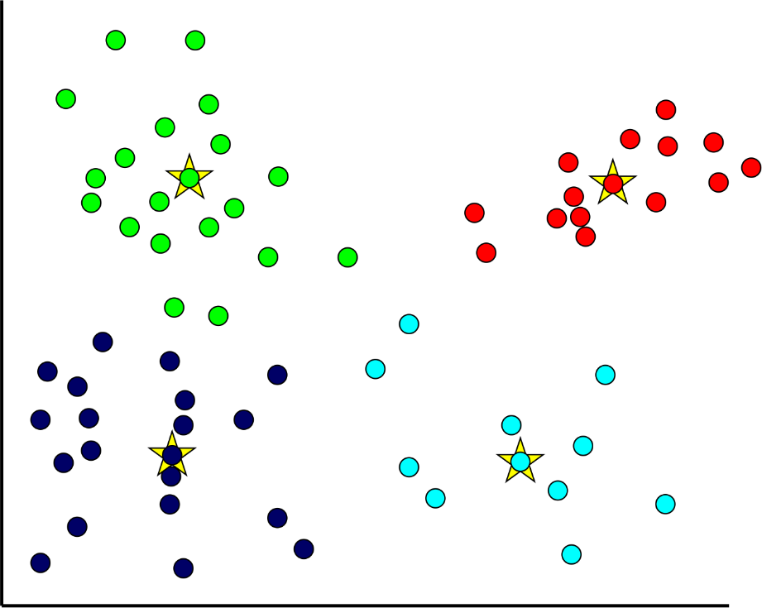
Unsupervised Learning (Clustering)

Slide 9
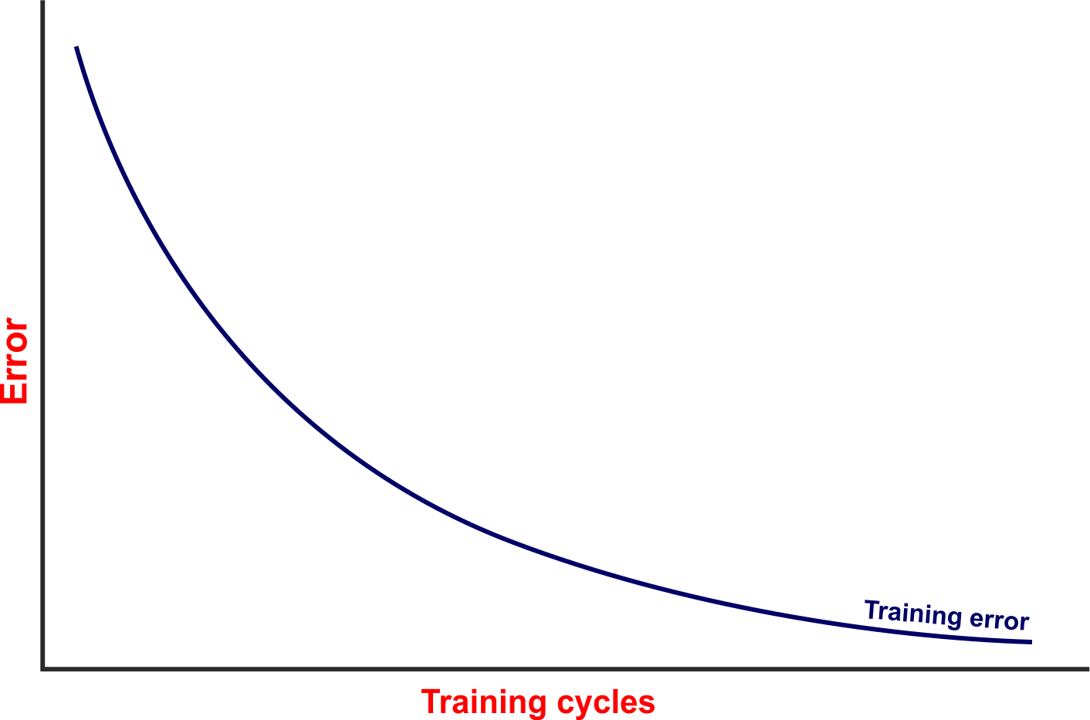
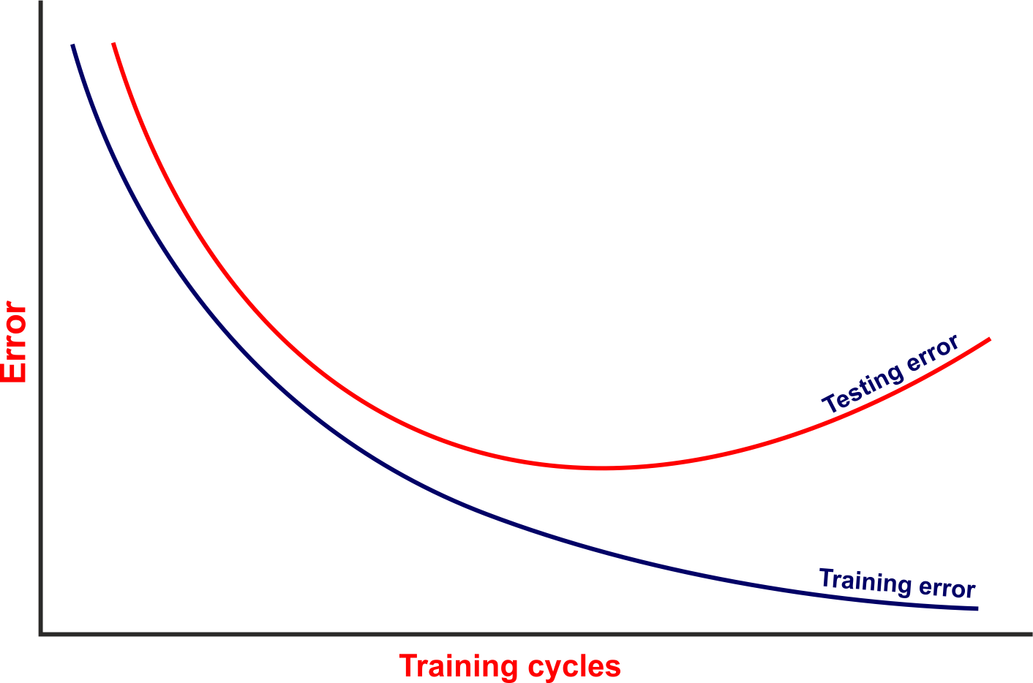
Over-fitting

